Slide 1


What’s in a name and pronoun?
Human Relations, Diversity & Equity
Student Support and Attendance Services
Notes:
Teacher, please feel free to encourage student participation whichever way you are most comfortable: in the Zoom chat, on a previously shared Jamboard, in break out groups, or all together in a grid view.

Slide 2
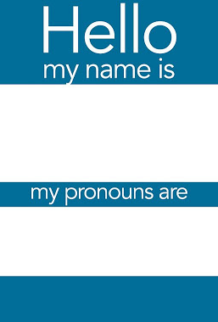
Check in:
If given the choice to name yourself, would you keep the name youwere given or would you change it?
Notes:
For this check in students can write “keep “ or “change” or elaborate in the chat. They can also share their name and pronouns.

Slide 3
Objectives
Learn about why it is important to use a person’s preferred name and pronouns when referring to them.
01
Understanding that although it may be challenging at first to use a new pronoun or name for someone, it is respectful to do so.
02
Feel empowered to ask that your correct name be used as well as pronounced appropriately and state your pronouns and ask others about theirs.
03
Notes:
Read the objectives to students.

Slide 4
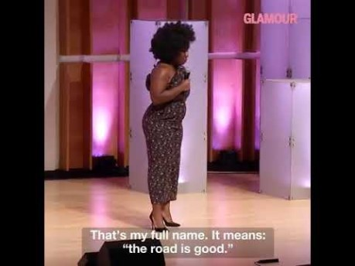
Notes:
(Two minute video about Uzoamaka Nwanneka a Nigerian-American actress known for her role in Orange is the New Black. ) 2:02 minutes , length of video. Video link: https://www.facebook.com/glamour/videos/10155598495785479/

Slide 5
Can you think of a time someone…
…forgot your name?
…insisted you go by a different or easier name?
…continued to mess up your name or pronouns even after you remind them?
How did that experience make you feel??
Notes:
Great opportunity to acknowledge empathy. How do you think it felt for Uzoamaka every time someone mispronounced her name? Have you felt the same?

Slide 6
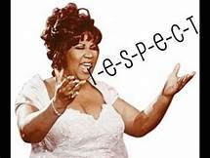
Using the proper pronunciation and name of someone is about kindness and respect. You should…
Feel empowered to share your name with others
Feel comfortable to correct others if they make a mistake
Advocate for yourself if you feel someone is intentionally refusing to use your name
Ask the proper pronunciation of someone’s name if you are unsure
Create opportunities for others to share their name with you
Notes:
Read slide.

Slide 7
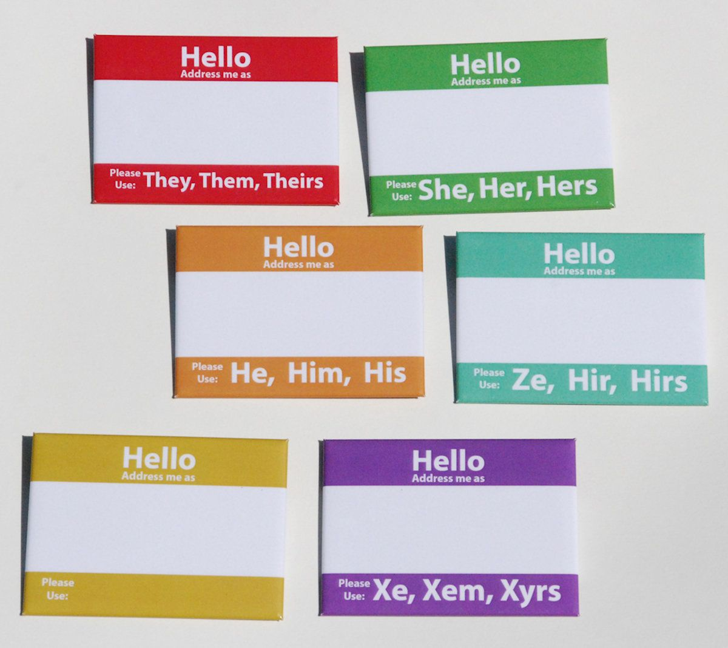
Don’t forget! While you are making sure to get someone’s name right, make sure to also ask them what their pronouns are.
Notes:
Pronouns are as important as names. The next short video on next slide will explain how to share and ask about pronouns to use.

Slide 8
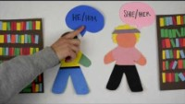
Notes:
1 minute 50 second video about importance of asking other’s about what pronouns to use for them. Link to video https://youtu.be/r-al4liNLBU

Slide 9
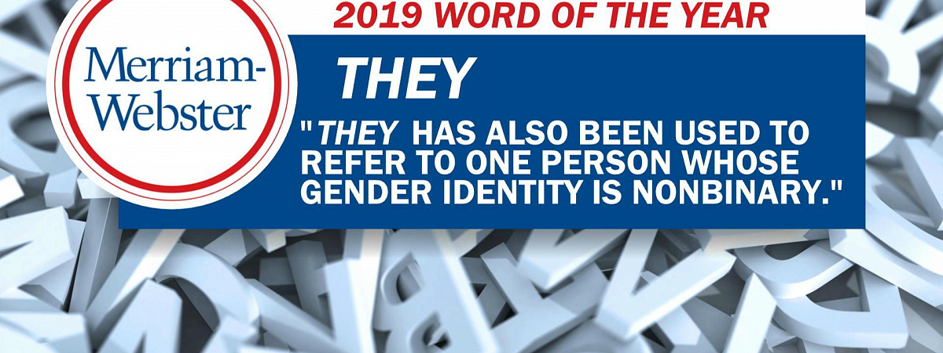
The pronoun “they”
We have always used the singular pronoun “they”.
For example, when we find a lost cellphone, we refer to the owner in the singular they pronoun; “Let me return this to them”.
Notes:
Read slide.

Slide 10

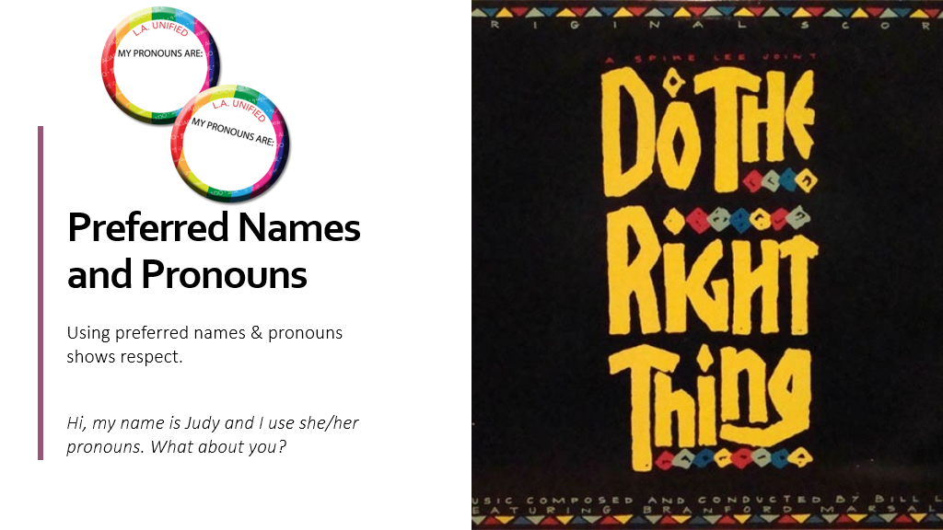
Names & pronouns
Using affirmed names and correct pronouns shows respect. We can all practice for example: Hi, my name is _____. I use the pronouns ____.
Notes:
Note to teacher- HRDE (Human Relations, Diversity & Equity) can send you pronoun pins (as pictured on slide) to share with students/staff. Visit our website for more info https://achieve.lausd.net/Page/17621

Slide 11

Mistakes will happen… you can get it right the next time, if you make a mistake.
A Quick, “sorry about that, I meant to say ___ “ shows you are trying and shows respect.
Notes:
Read slide or have two students read each half of slide.

Slide 12

How do you respect others?
When we respect others, we respect their identity and culture.
How can we show respect?
Ask for their pronouns when meeting someone new
Correct people when they use the wrong pronouns
Use the name and pronouns they ask you to use.
Apologize and correct yourself if you get it wrong.
Notes:
Read slide or have a different student reach each bullet.

Slide 13

Teacher Survey
Notes:
Teacher, please scan the QR code to take a brief survey.

Slide 14
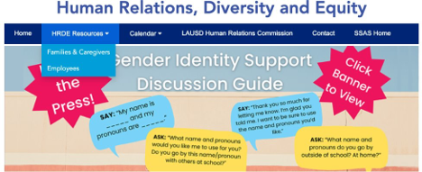
Human relations, diversity & equity
For additional resources, visit us at: https://www.lausd.org/human-relations

